Slide 1
Machine learning workshop
National Central University
FFL lab
Presenter: Cao, Hoang-Tien (高宏天)

Slide 2
Outline
DNN model
Particle Swarm Optimization

Slide 3
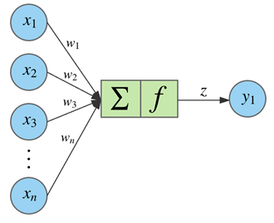
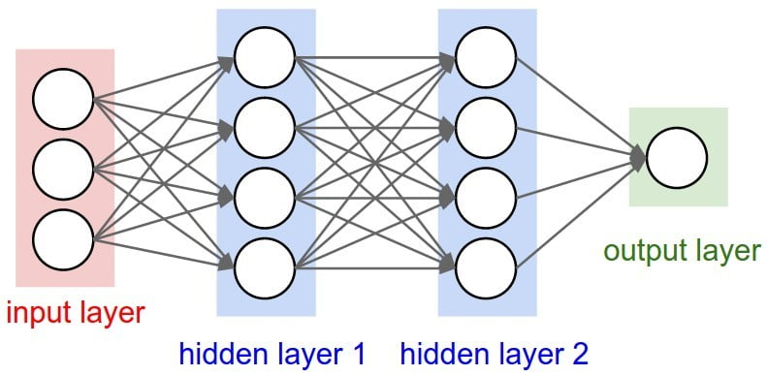
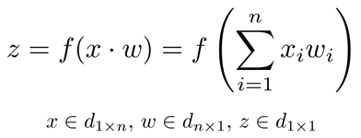
1. DNN model

Slide 4
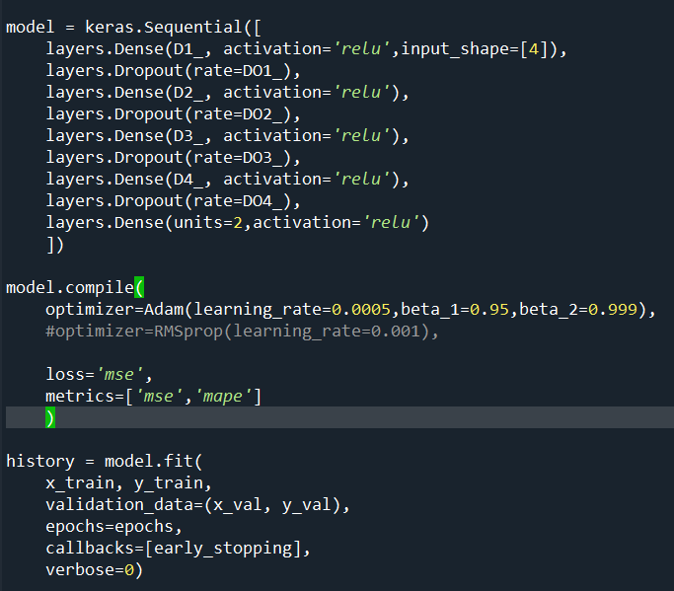
Python Keras library
Steps
Define DNN architecture
Compile DNN model
Train the model
Use the model

Slide 5
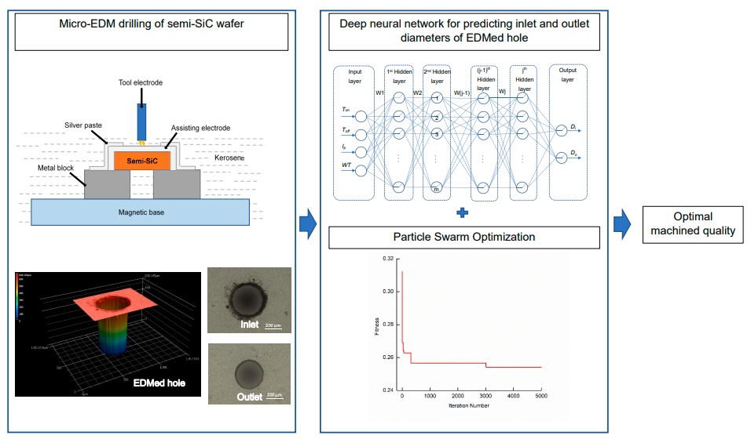
Exercise 1
Build a DNN model: 4 inputs, 4 hidden layers, 2 outputs
Code: ex1.py

Slide 6
2. Particle Swarm Optimization

Slide 7
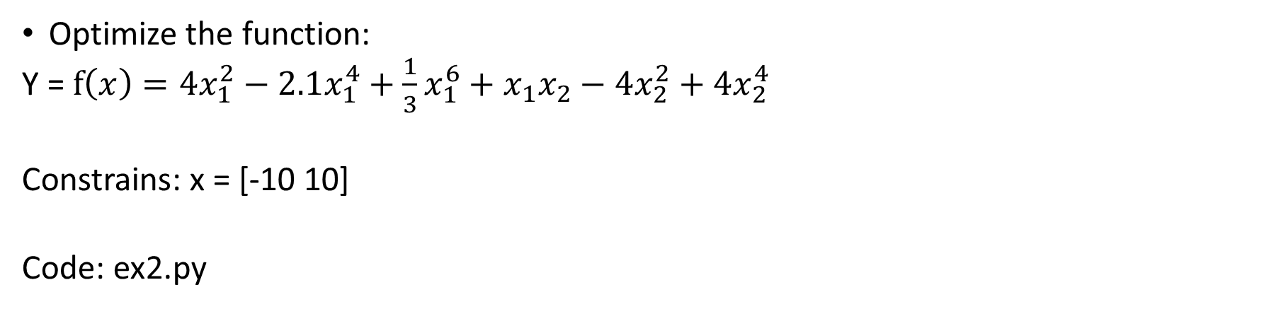
Exercise 2
Optimize the function:
Y = $f\left(x\right)=4x_{1}^{2}−2.1x_{1}^{4}+\frac{1}{3}x_{1}^{6}+x_{1}x_{2}−4x_{2}^{2}+4x_{2}^{4}$
Constrains: x = [-10 10]
Code: ex2.py

Slide 8
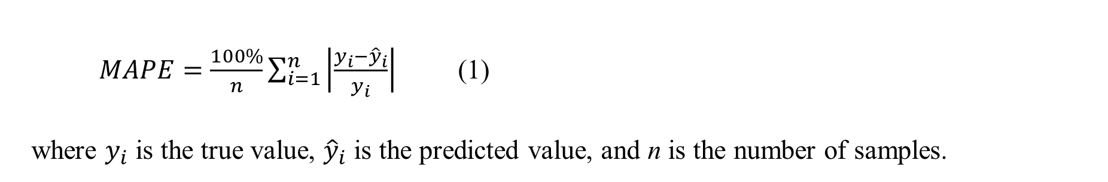
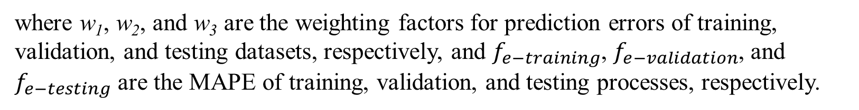
Optimizing DNN architecture using PSO
Cost function: $f={w_{1}f}_{e−training}+w_{2}f_{e−validation}+w_{3}f_{e−testing}$
where w₁, w₂, and w₃ are the weighting factors for prediction errors of training, validation, and testing datasets, respectively, and $f_{e−training}$, $f_{e−validation}$, and $f_{e−testing}$ are the MAPE of training, validation, and testing processes, respectively.
$MAPE=\frac{100\%}{n}\sum_{i=1}^{n}{\left|\frac{y_{i}−{\hat{y}}_{i}}{y_{i}}\right|}$ (1)
where $y_{i}$ is the true value, ${\hat{y}}_{i}$ is the predicted value, and n is the number of samples.

Slide 9
Exercise 2
Code: ex3.py

Slide 10
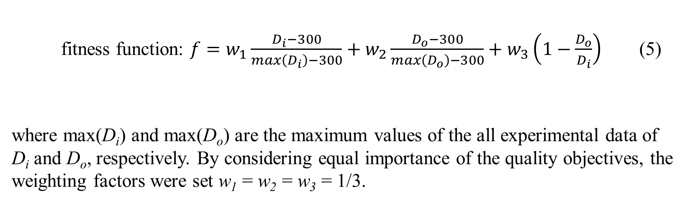
Optimizing Machining Parameters using PSO
fitness function: $f=w_{1}\frac{D_{i}−300}{max\left(D_{i}\right)−300}+w_{2}\frac{D_{o}−300}{max\left(D_{o}\right)−300}+w_{3}\left(1−\frac{D_{o}}{D_{i}}\right)$ (5)
where max(D_{i}) and max(D_{o}) are the maximum values of the all experimental data of D_{i} and D_{o}, respectively. By considering equal importance of the quality objectives, the weighting factors were set w₁ = w₂ = w₃ = 1/3.

Slide 11
Exercise 3
Code: ex4.py

